Slide 1

STUDENT
ENROLMENT
FORM
“HOW –TO GUIDE”

Slide 2


STUDENT ENROLMENT
STEP 1: LOGIN
STEP 2: BEGIN ENROLMENT FORM
STEP 3: REVIEW & CONFIRM COURSES
STEP 4: SUBMIT ENROLMENT FORM

Slide 3
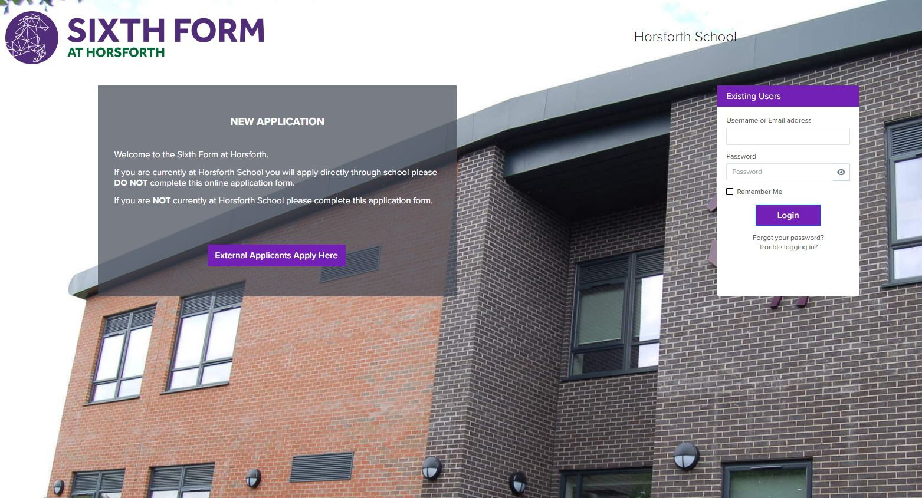
LOGIN
Go to your Admissions+ portal
1
Login using your
email address & password.
2
Please check your emails for
your username & password or use the “forgot your password” link
3

Slide 4
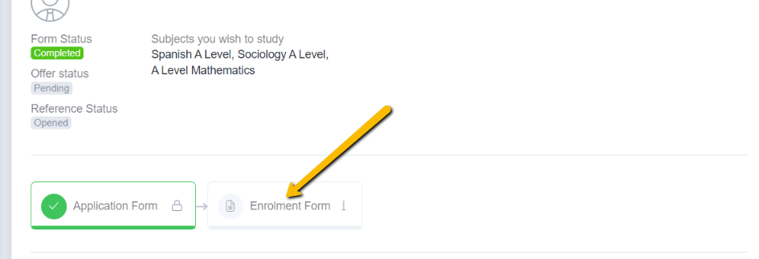
BEGIN
ENROLMENT FORM
Click to begin the enrolment phase of your application.

Slide 5
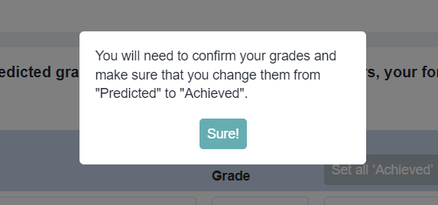
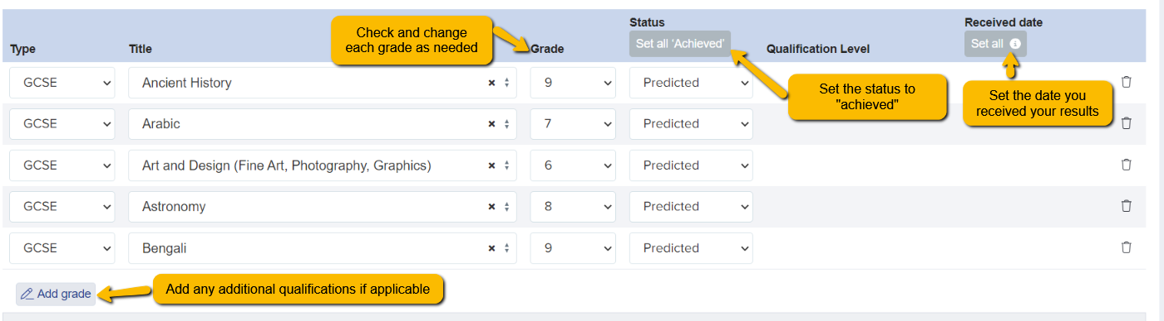
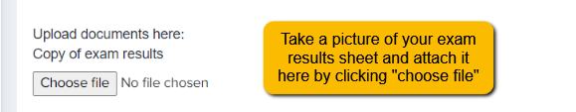
CONFIRM YOUR ACHIEVED GRADES

Slide 6

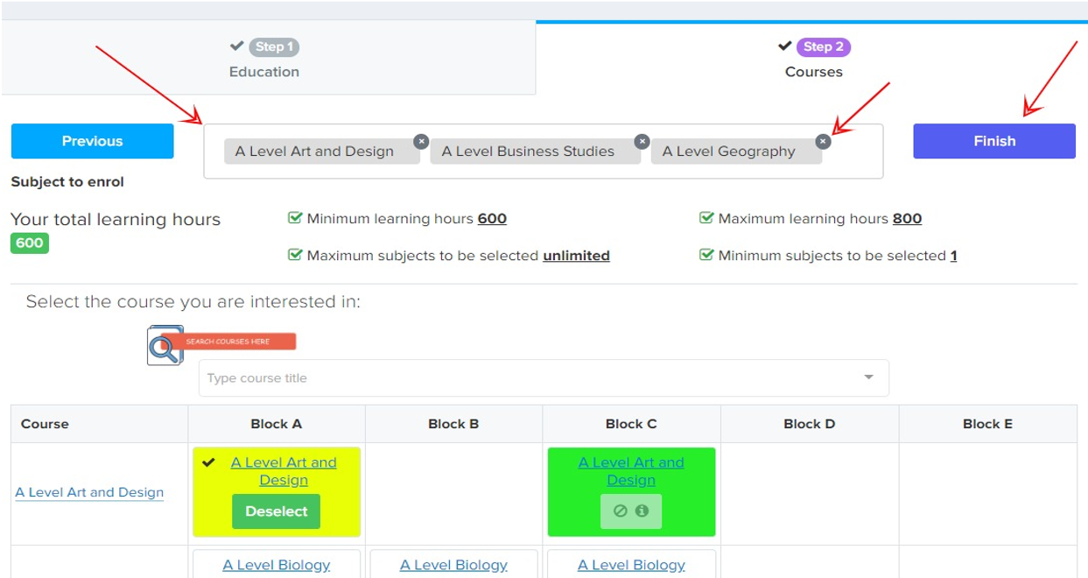
REVIEW & CONFIRM COURSES
Review and confirm the courses
you have chosen to study
1
If you would like to modify your
course choices, click the ‘x’ icon
on the course you want to
remove
2

Slide 7
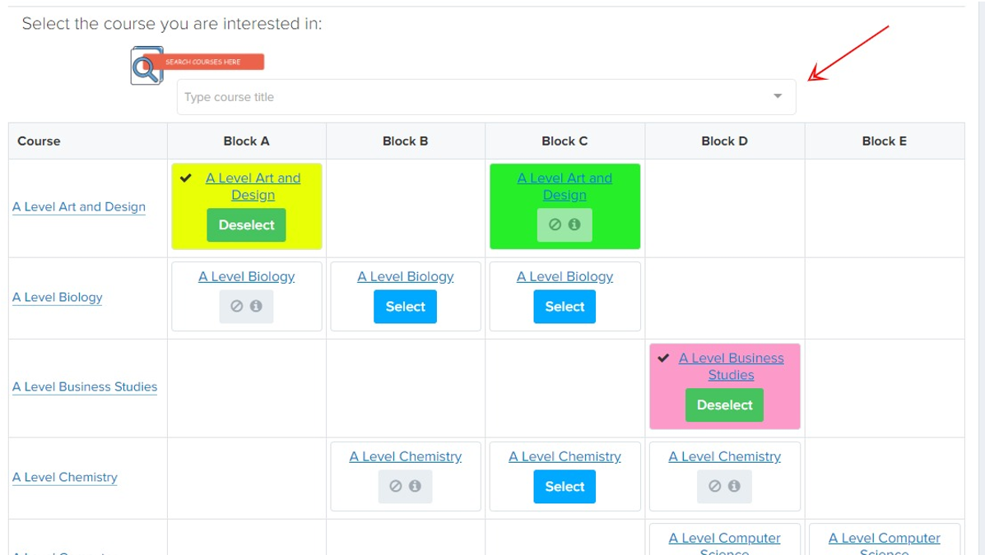
Search for new courses:
1
Scroll through the list
of courses in the table
2
Use the search bar
Select the course you would like
to study and click ‘Finish’ on the
top right hand corner to submit
the courses you would like to study.
REVIEW & CONFIRM COURSES

Slide 8
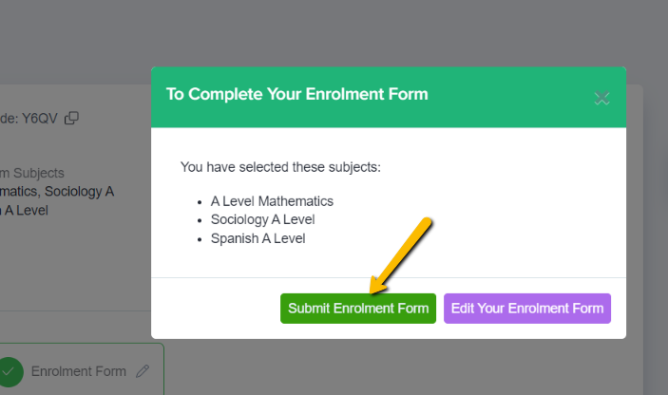
SUBMIT ENROLMENT FORM
Click ‘Submit Enrolment Form’ to save your changes and submit the Enrolment Form to the school.

Slide 9
THANK YOU

